Slide 1
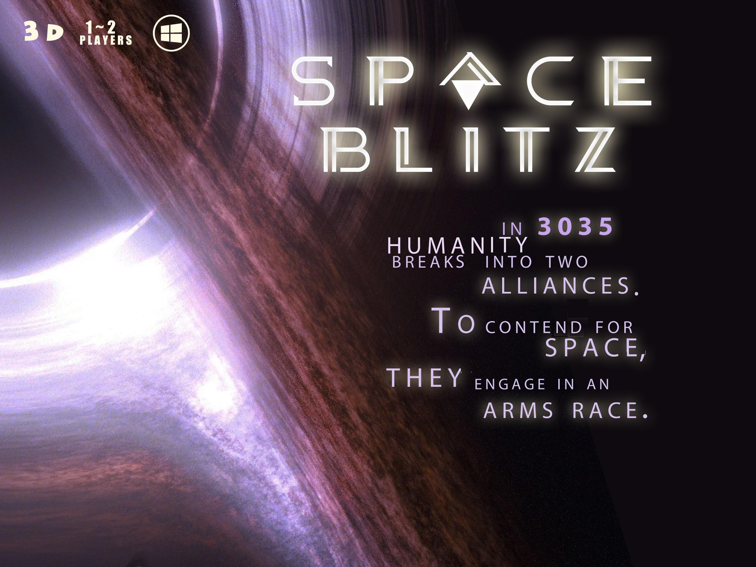
B.S. Studios

Slide 2
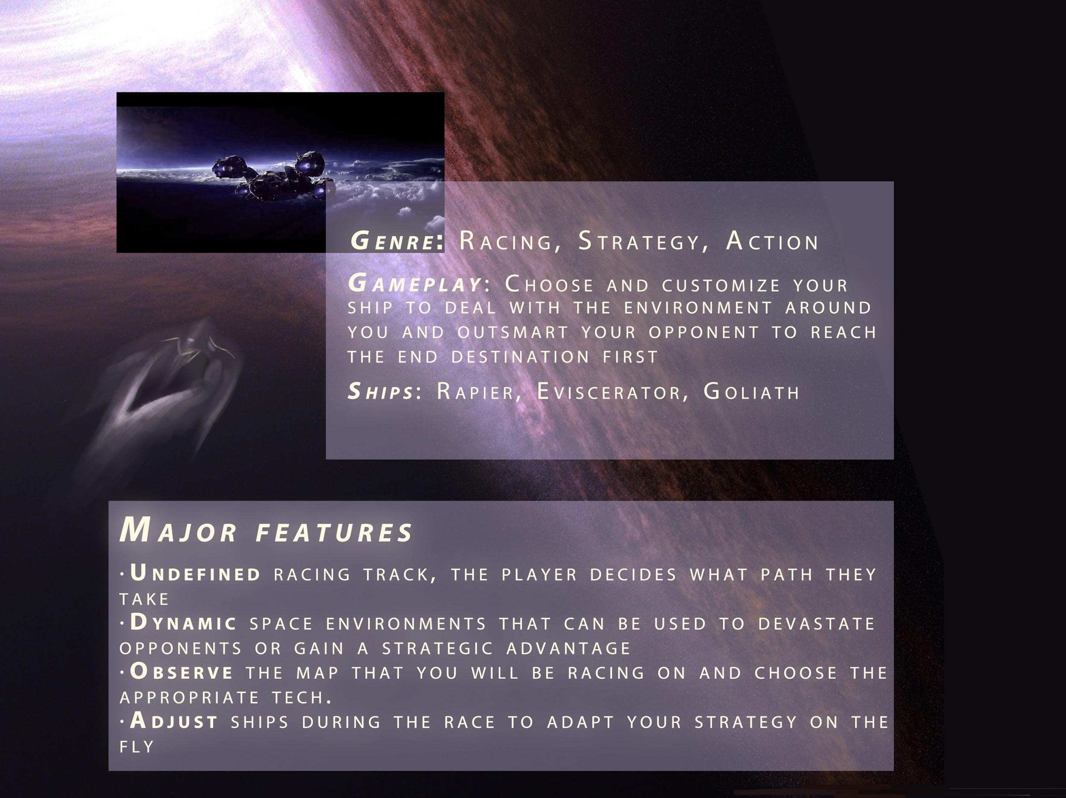

Slide 3
How to achieve our goals?

Slide 4
Software Architecture
·Individual game-logics configured for each map.
·Separate classes for each type of ship.
·Allows for easy addition of new locations.
·Allows for easy addition of new ship types.

Slide 5
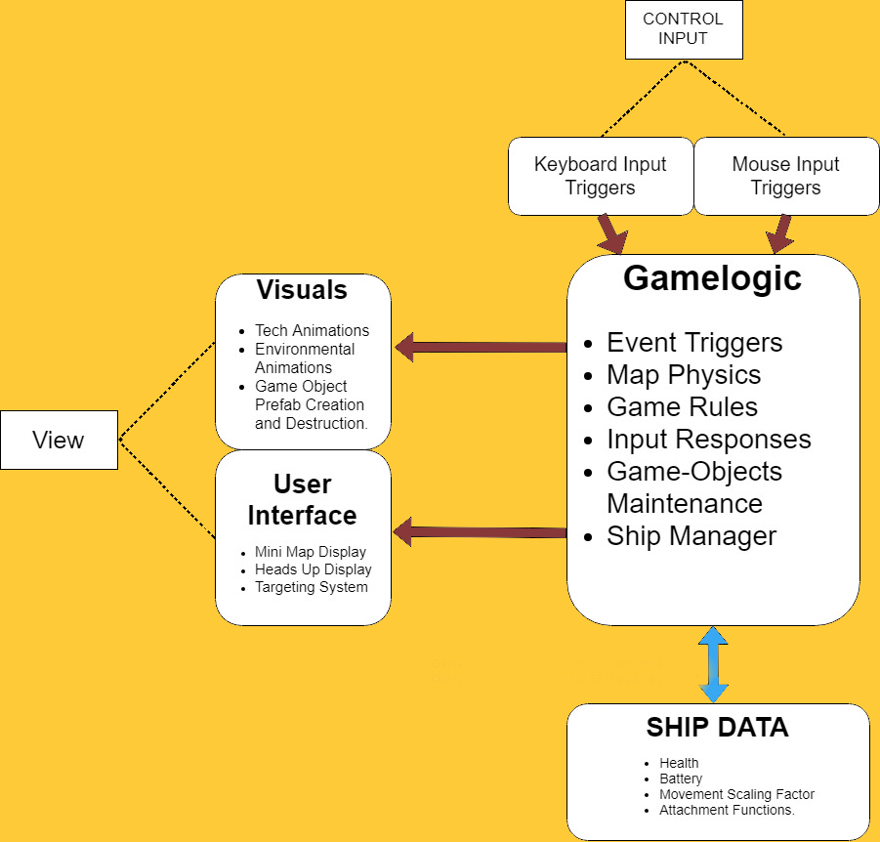

Slide 6

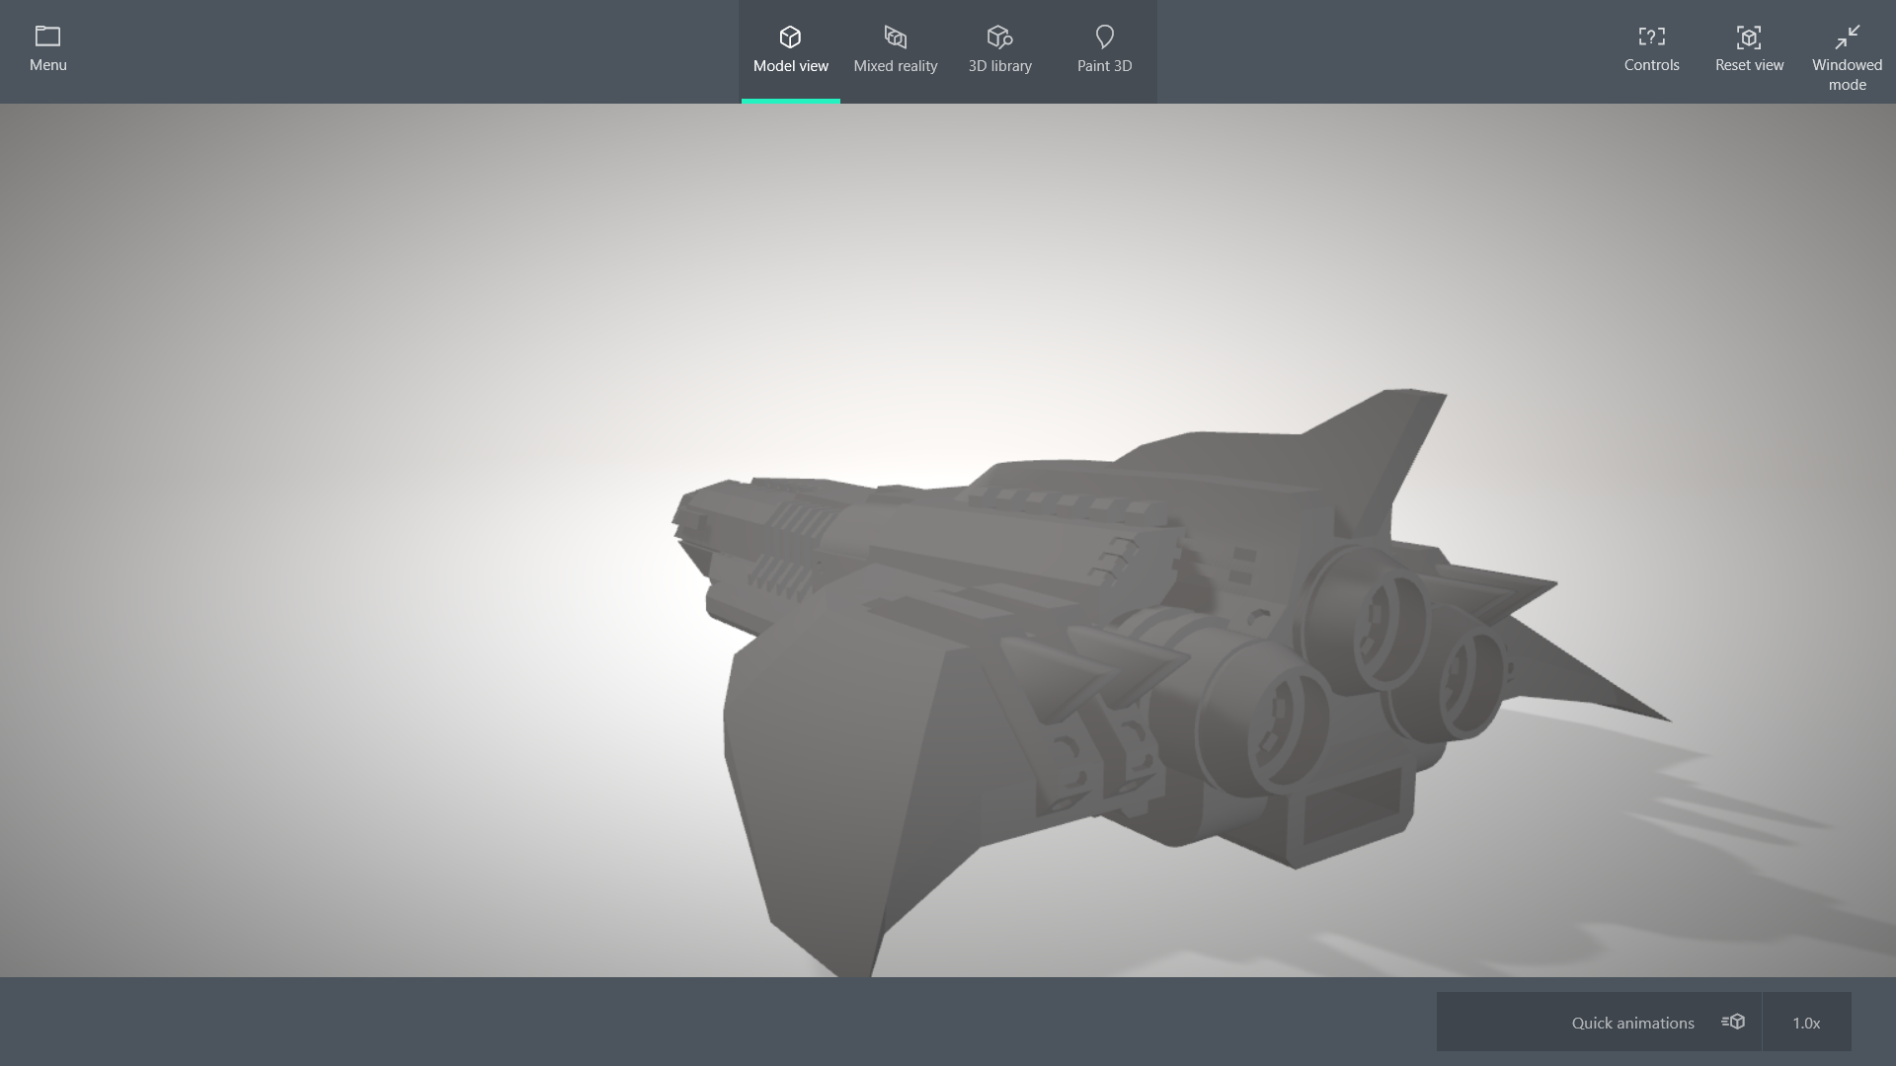
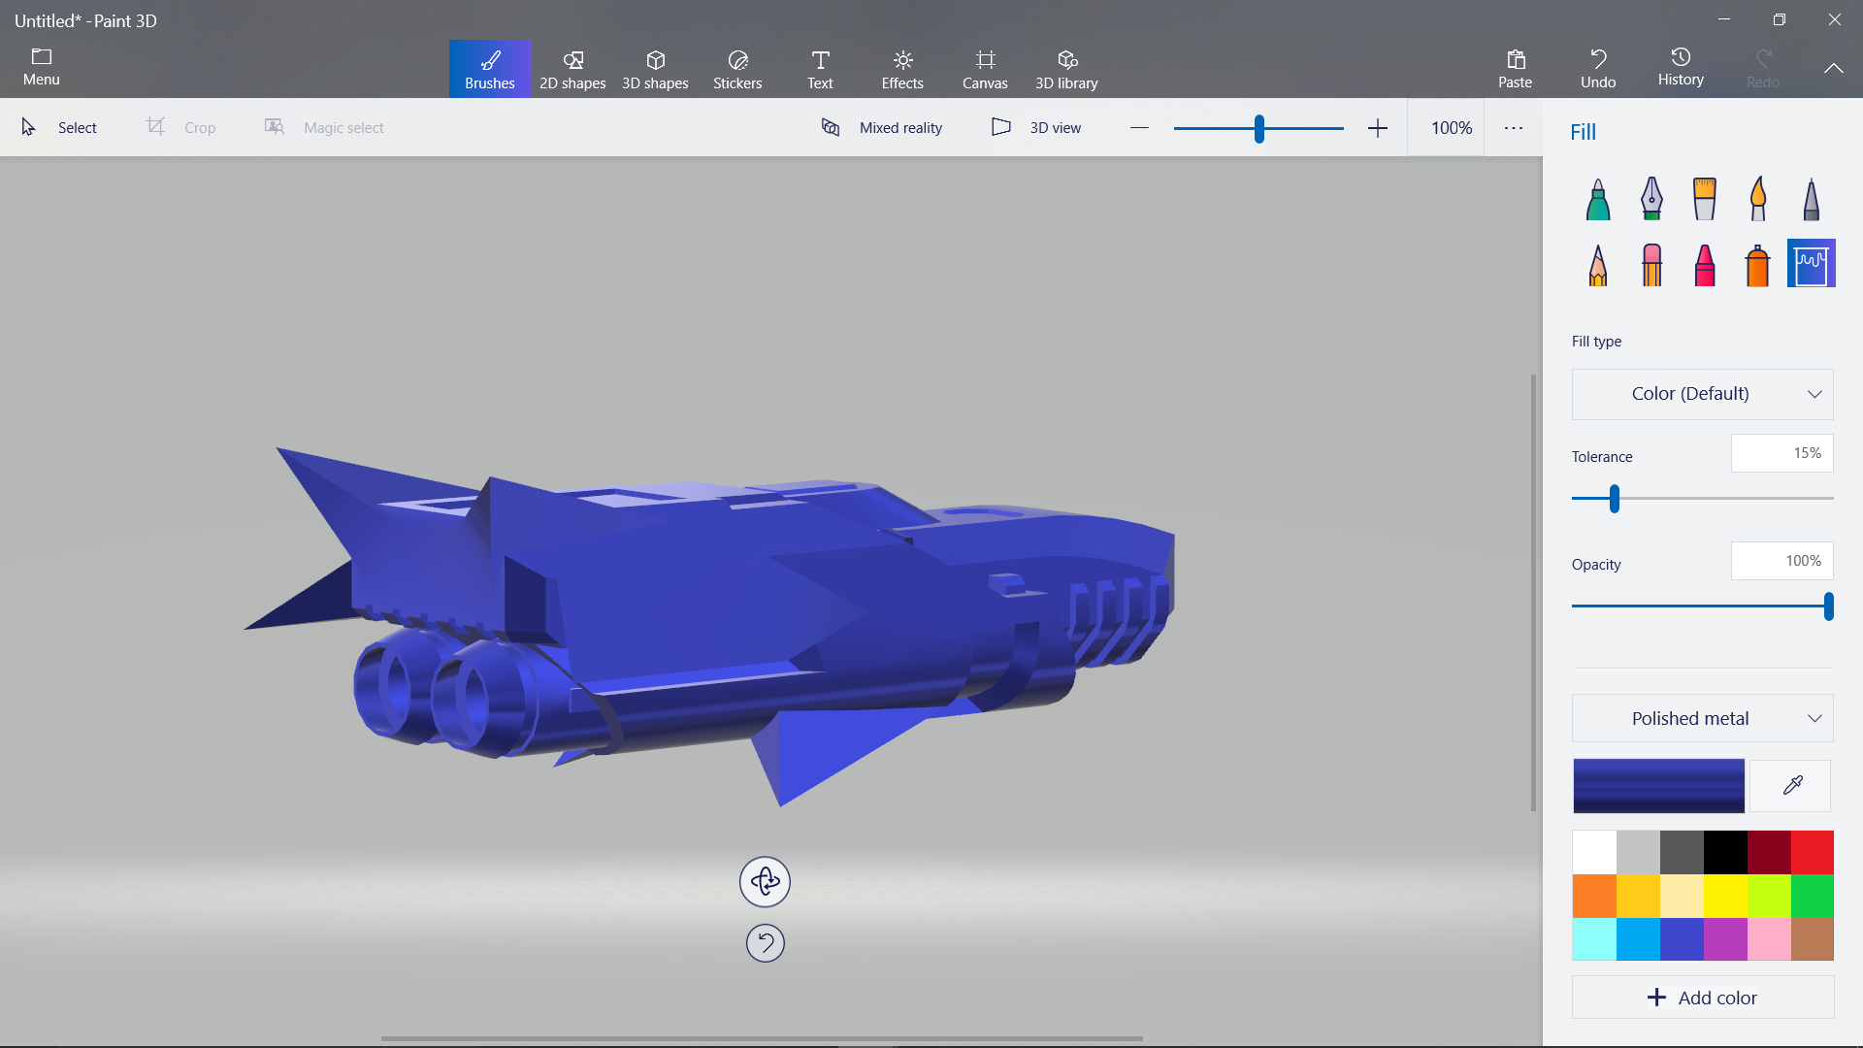
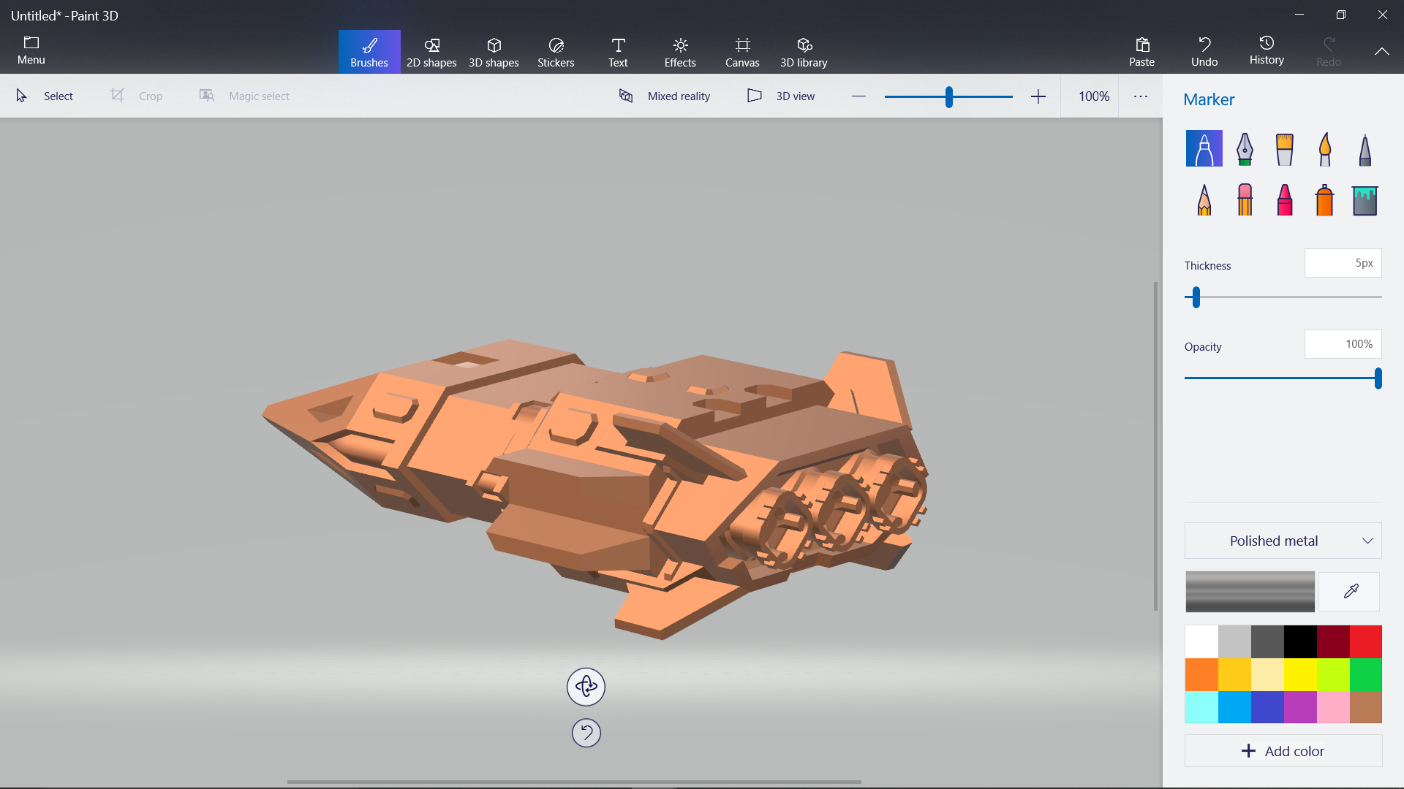
Game Engine: Unity3D
Art Assets: Public domain

Slide 7
Risk

Slide 8

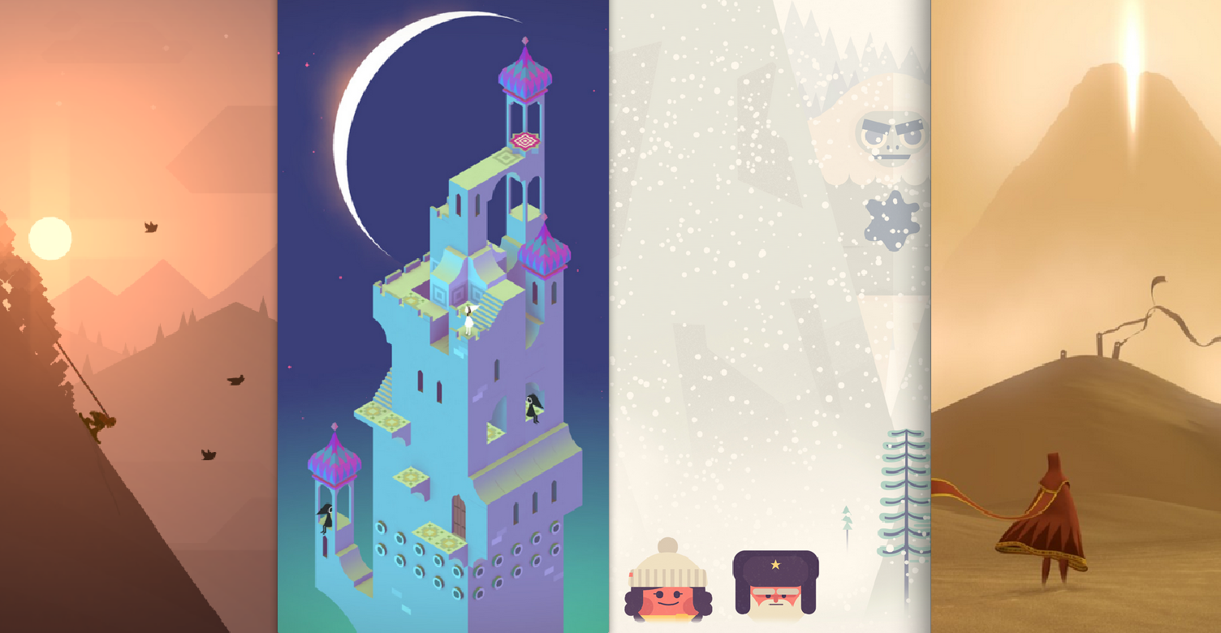
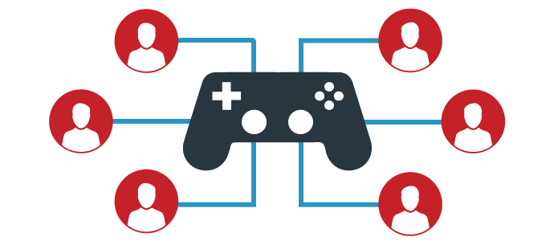
Risk
·AI balancing can be difficult because of rules
·Aesthetics & assets are strictly from public domain
Multiplayer versus mode networking

Slide 9
Q&A

